Slide 1
Reporting and Writing I
Reporting on local government

Slide 2
Council stories (groan)
Councillors are to debate…
Medway Council is to…
Kent Council Council has decided…
…according to councillors.
The council will cut spending on…
A council overview and scrutiny committee will…

Slide 3
Why we do them…
About a quarter of all money spent on public services is controlled by local councils.
That money is spent on things people care about:
Schools
Benefits
Roads
Waste collection
In figures: 2012/13
£39.2bn on education
£21.2bn on social care
£19.6bn on housing benefits
£11.6bn on police
27.1% of local authority spending will be funded by Council Tax.

Slide 4
Council stories
In the nationals
Cherry-pick issues
Tend only to report on staggering examples of waste, health and safety gone mad, or decisions that reflect on national govt policy
In the regionals
Hold local decision making to account – how local taxes are spent
Level of detail cannot be matched by nationals
Focus on needs of local community

Slide 5
Tiers of local government
Unitary authority
Parish council
Town council
County council
Parish council
Borough and district councils

Slide 6
Tier 2
Benefits
Waste collection
Planning
Museums
Theatres
Car parks
Leisure
Medway Council
Snodland Town Council
Leybourne Parish Council
Kent County Council
Cuxton Parish Council
Tonbridge and Malling Borough Council
Cooling Parish Council
Halling Parish Council
Tier 1
Schools
Social care
Roads (ex. Mways)
Libraries
Waste disposal
Strategic planning
Trading standards
Tier 3
Village halls
War memorials
Local play areas
Church graveyards
Bus shelters
Community events
Planning (consult)

Slide 7
Councillors
Elected*
*Usually
Make decisions
In public meetings
Generally in a four-year cycle
It means they are accountable to the public for their actions
Key decisions made by leader and cabinet members
Other councillors sit on committees, e.g. planning, licensing.

Slide 8
Officers
Not elected
Full time professionals
Advisers
Not decision makers
They stay in post regardless of which party wins an election
Often arranged into depts that specialise in one policy area.
Experts in law, finance, planning, etc
Do attend meetings and speak – but cannot vote.

Slide 9
As sources…
Councillors
Should always speak to you to explain decisions / give opinion
You do not have to approach them through a council press office
Contact details should be available to the public via the council’s website
Officers
Don’t expect them to justify a council’s decisions – but they can provide background info and facts
You will probably have to go through a council press office to get hold of them.

Slide 10
http://medway.gov.uk/councilanddemocracy/cabinetportfolios.aspx
An energy company announces plans to build a wind farm on the Hoo Peninsula.
It would generate enough power to serve all of Medway each year.
Who at the council can help you with the story? How?

Slide 11
Wind farm
Cllr Rodney Chambers – leader
As leader, he would have a say on any major plan for the area. Does he support the plan? What are the benefits, and the dangers?
Cllr Jane Chitty – strat plan & growth
Major plans land in her in-tray. What’s the process for approving this plan? How will the public consultation work?
Robin Cooper – director
Regeneration, Community and Culture boss: Advice on policy, process, funding and how the council will deal with the proposal

Slide 12
Wind farm
Human angles
Nearby residents
Noise concerns? Disruption during building? Is the plan good?
Conservation groups
Would the farm affect any birds? Any other creatures at risk?
Ramblers’ clubs etc.
Is the countryside used for any leisure activities?
Farmers / rural businesses
What impact will it have?
But the story wouldn’t end there…
Stories are never council stories
They are always people stories
So who else would you talk to?

Slide 13
Pub quiz!
You need to know how councils work – but to our readers, that stuff is boring.
They just want to know how council decisions affect them.
But when stories arise, you need to know which council is responsible for an issue.
Get in teams of four, for a…

Slide 14
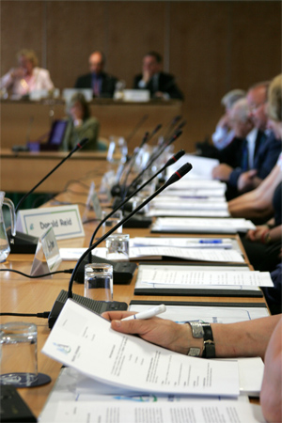
Meetings
All council meetings are open to the public – but not all are worth attending!
Dates and times are published on council websites and at town halls
Agendas are published a week in advance – and tell you exactly what is going to be debated

Slide 15
How councils work
Leader or elected mayor
Cabinet
Backbenchers
Planning committee
Scrutiny committees
Full council
Licensing committee

Slide 16
What’s going on?
Finding agendas
Go to www.medway.gov.uk
Click on “Council and democracy”
Scroll down the text until you find the “Council meetings” link
This opens a calendar of meetings
Click on “Planning committee” on Nov 14
Agendas give you a good idea of what you’re in for…
Use them wisely
We’re going to look at what’s happening at tomorrow’s planning meeting

Slide 17
Basics
Look for an agenda frontsheet
It tells you where and when the meeting will be held
The print (or pdf) version also gives you the surnames of every councillor on the committee.
That will be useful!

Slide 18
Basics
Jargon
You will see some horrific language used in council reports. Never allow it to be repeated in your stories!
Process
Don’t write about the process of a council meeting – unless there is a proper reason to. Always look for ways to relate a debate to your readers’ lives.
Meetings are not covered as one event.
Each item is a separate story.
And you must weigh up whether each item is worth covering at all.

Slide 19
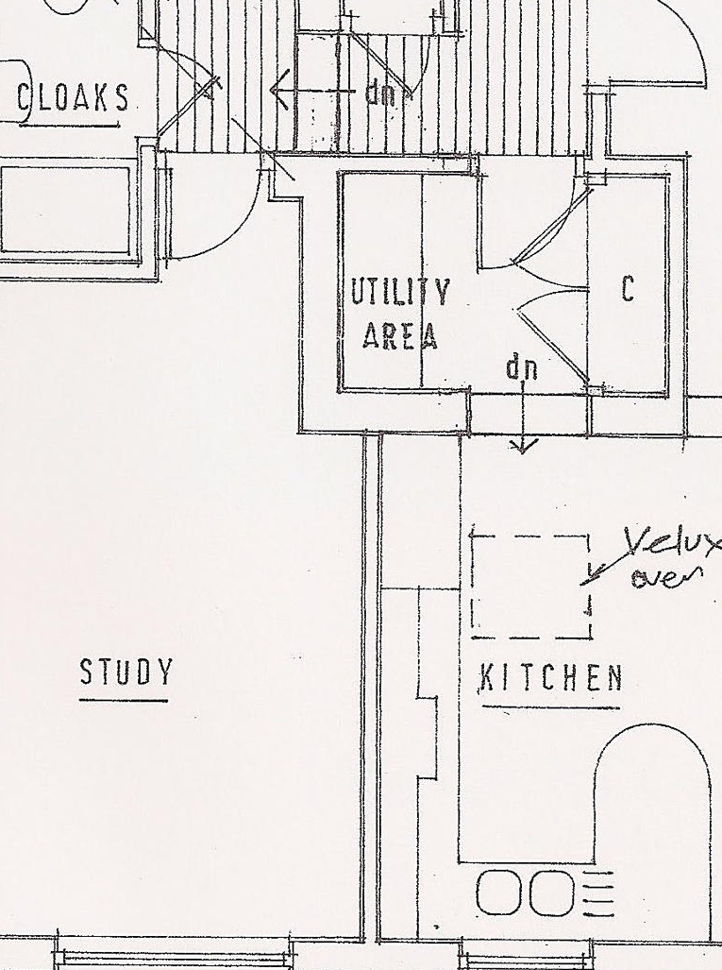
Spotting stories
Look down the list quickly – tell me which two items will make the best stories.
34 homes at Amherst Hill
Bank turning into a café in Gillingham
Why are these the best stories?
Why ditch the others?

Slide 20
New café?
Click on the “report” link for item 10 – the bank.
Reports to council meetings all follow the same format.
There will be a recommendation, and background details.
Skim read it and make a note of a potential angle for the story.

Slide 21
New café?
Questions Is the bank already closed?
Is the café plan popular in the area?
If not, why not?
Is the café plan going to be approved?
Are there any elements of the recommendations that interest you for your story?
Answers To cover this story you have this report and you can attend the meeting.
But what else would you do to get the full story?

Slide 22
The human angle
Watling Street
Ask nearby residents about noise, light, smells, antisocial behaviour caused by takeaways etc.
Would a café opening to 6pm, rather than 11pm, be acceptable?
What do you want to open there?
Café owner
Was hot food takeaway & late opening important to your business plan?
Do you still want to go ahead?
Council
How will you enforce the hot food takeaway rule?

Slide 23
Telling a story…
Councillors have approved a plan to convert a Gillingham bank into a café – on condition it does not sell takeaway hot food.
A former Lloyds bank in Gillingham will be turned into a cafe, as long as it closes by 6pm and does not sell takeaway hot food.
Opening a new café in Gillingham would be a disaster for the area, say frustrated residents.
Last night a plan to convert the former Lloyds Bank in Watling Street into a café and two flats was given a conditional green light.
That was despite the objection of 175 residents, who complained about noisy deliveries, littering, light pollution and the impact on other local businesses.

Slide 24
New houses
Now look at the reports for items 5 and 6
Skim read again – there’s a lot of info there!
What are the key points of this story?
And what other interesting angles are there?

Slide 25
New houses
Key points
34 homes at Amherst Hill
WW2 bomb shelters to go
Historic site restoration
Other angles
Forms part of proposed World Heritage Site
Section 106 agreement: £76k for primary school, £31k for nursery school, £46k for traffic calming, £50k for restoration
List of conditions before building can start

Slide 26
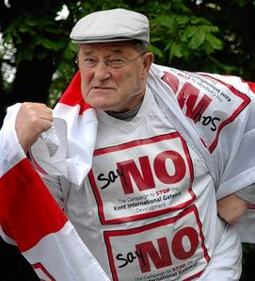
Big plans…
Kent International Gateway
A 285-acre site with warehouses for road and rail freight, near Maidstone:
20 detailed planning documents
A two volume assessment of its environmental impact
More than 3,500 comments from residents
It’s vital to be able to get quickly to the important info, and not waste time on the stuff you don’t need.
http://www.maidstone.gov.uk/environment_and_planning/planning/kent_international_gateway.aspx

Slide 27
Other meetings
Cabinet
Attended by leading party (-ies)
Leader and a handful of cabinet members
Makes all “key” decisions
But there is little debate – they all agree on the issues already
Cabinet members often take decisions in advance
Full council
Every councillor attends
The biggest decision it makes is the budget every February.
Approves the spending plan for the coming financial year
And the rate of council tax
Question time
Petitions

Slide 28
Scrutiny committees
Watchdogs Scrutiny committees have members from all parties
They have the power to “call-in” decisions made by the cabinet
It is an attempt to balance out the democratic problem of the cabinet system – that there is no debate when key decisions are made.
Scrutiny committees and full council are the only meetings where you fill find genuine debate. It may not be as exciting as it sounds, though…

Slide 29
What can you report?
Council meetings, official publications and press conferences are covered by qualified privilege.
It provides you with a defence against being sued for defamation as long as your report meets three conditions:
The report must be balanced and accurate
The report must be published without malice
The report must be published contemporaneously (i.e. as soon as possible)

Slide 30
Defamation
A libel is a statement that would be likely to:
Cause loss in trade or profession
Cause someone to be shunned or avoided
Expose them to hatred or ridicule
Lower the estimation of someone in the mind of right-thinking people
“Maidstone is the County Town of Kent but it is lagging behind. Tunbridge Wells and Canterbury are investing in their town centres, and Bluewater is becoming the county’s premium shopping destination. Our footfall figures are still strong but people are spending their money elsewhere. All we have is the Chequers Centre, with its uninspiring mix of shops and its awful bus terminal. Frankly, the IRA should have blown it up years ago. It would have done us all a favour.”

Slide 31
Using it in a story…
A STUNNED town hall heard a councillor claim the “IRA should have blown up the Chequers Centre” last night.
Councillors fell into a shocked silence after Cllr Clive English (Lib Dem) told the planning committee a bomb blast would have “done us all a favour” during a debate on how to revitalise Maidstone’s town centre.
In 1975 The Hare and Hounds pub, which was regularly used by soldiers at the town’s Invicta Barracks, was severely damaged in an IRA bomb blast.
Other councillors were quick to condemn the comments as “insensitive” and “inflammatory”……… etc.

Slide 32
Keep it in context
Remember – the report must be “fair and accurate” and “without malice”.
If he apologised immediately, you must say so.
If it was said as a joke – even in bad taste – you must say so.
Would you get a comment from him after the meeting?
You don’t have to – he said it, and as long as it is reported in context there is no obligation to let him explain himself.
You might choose to.

Slide 33
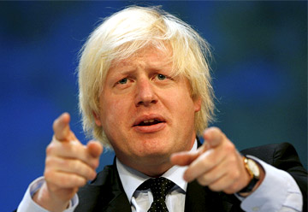
Defamation
Defamation cases have been attempted in bizarre circumstances…
Boris Johnson was accused of libelling Ken Livingstone in an election leaflet which said “Not Ken again” and warned that re-electing the Labour candidate in London would lead to:
Waste of public money
Loss of jobs
Increase in Council Tax
Bob Crow, gen sec of the RMT, said Boris’ claims would “adversely effect his [Ken’s] re-election chances.”
A judge threw out the claim - saying it was all a part of the election process.

Slide 34
Finding stories - tips
Agendas
Published a week in advance
Cabinet agendas will tell you about decisions
Cuts in services
New capital projects
Schemes & campaigns
Scrutiny agendas will tell you about burning issues & areas of political friction
Local councillors
Every councillor represents a ward – a village, or an area of a town
They will know about issues affecting their area
Speak to them regularly (even when you’re not chasing a specific story)

